Slide 1
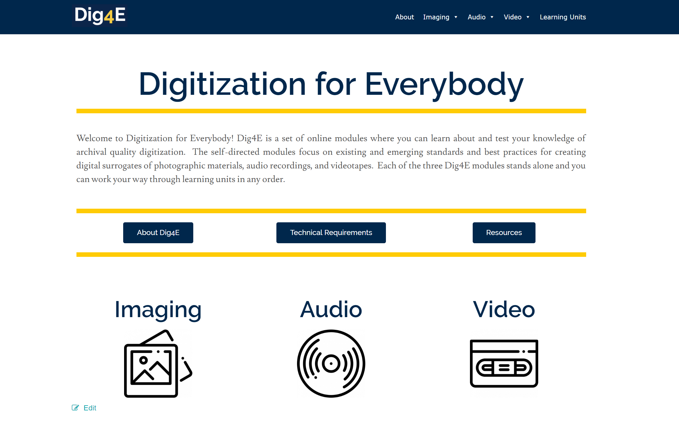
Paul Conway
University of Michigan School of Information

Slide 2
Notes:
Knowledge gap between longstanding practices in the field and the maturing technical infrastructure for the digital conversion of text/graphic, audio, video, and film.
Decades of research image science embedded in standards and guidelines, all of which are difficult to understand and apply and which sometimes fly in the face of decades of best practices in the cultural heritage sector.

Slide 3
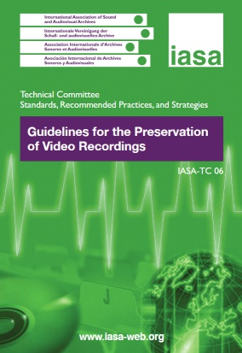
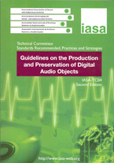
Notes:
Archival quality digitization is not a solved problem. We need to understand the technical, organizational, and administrative of creating surrogates of our collections in a way that help ensure that digital representations are preservable, widely useful, and universally sharable.
The challenge extends to audio resources, video resources, and to a less ubiquitous degree to analog film.
The technical guidance to do good work is widely distributed and supported by an alphabet soup of organizations across the globe. These organizations derive their standards and best practices from industry mandates, government regulations, scientific research, and occasionally from the needs and expectations of libraries, archives, and museums.

Slide 4
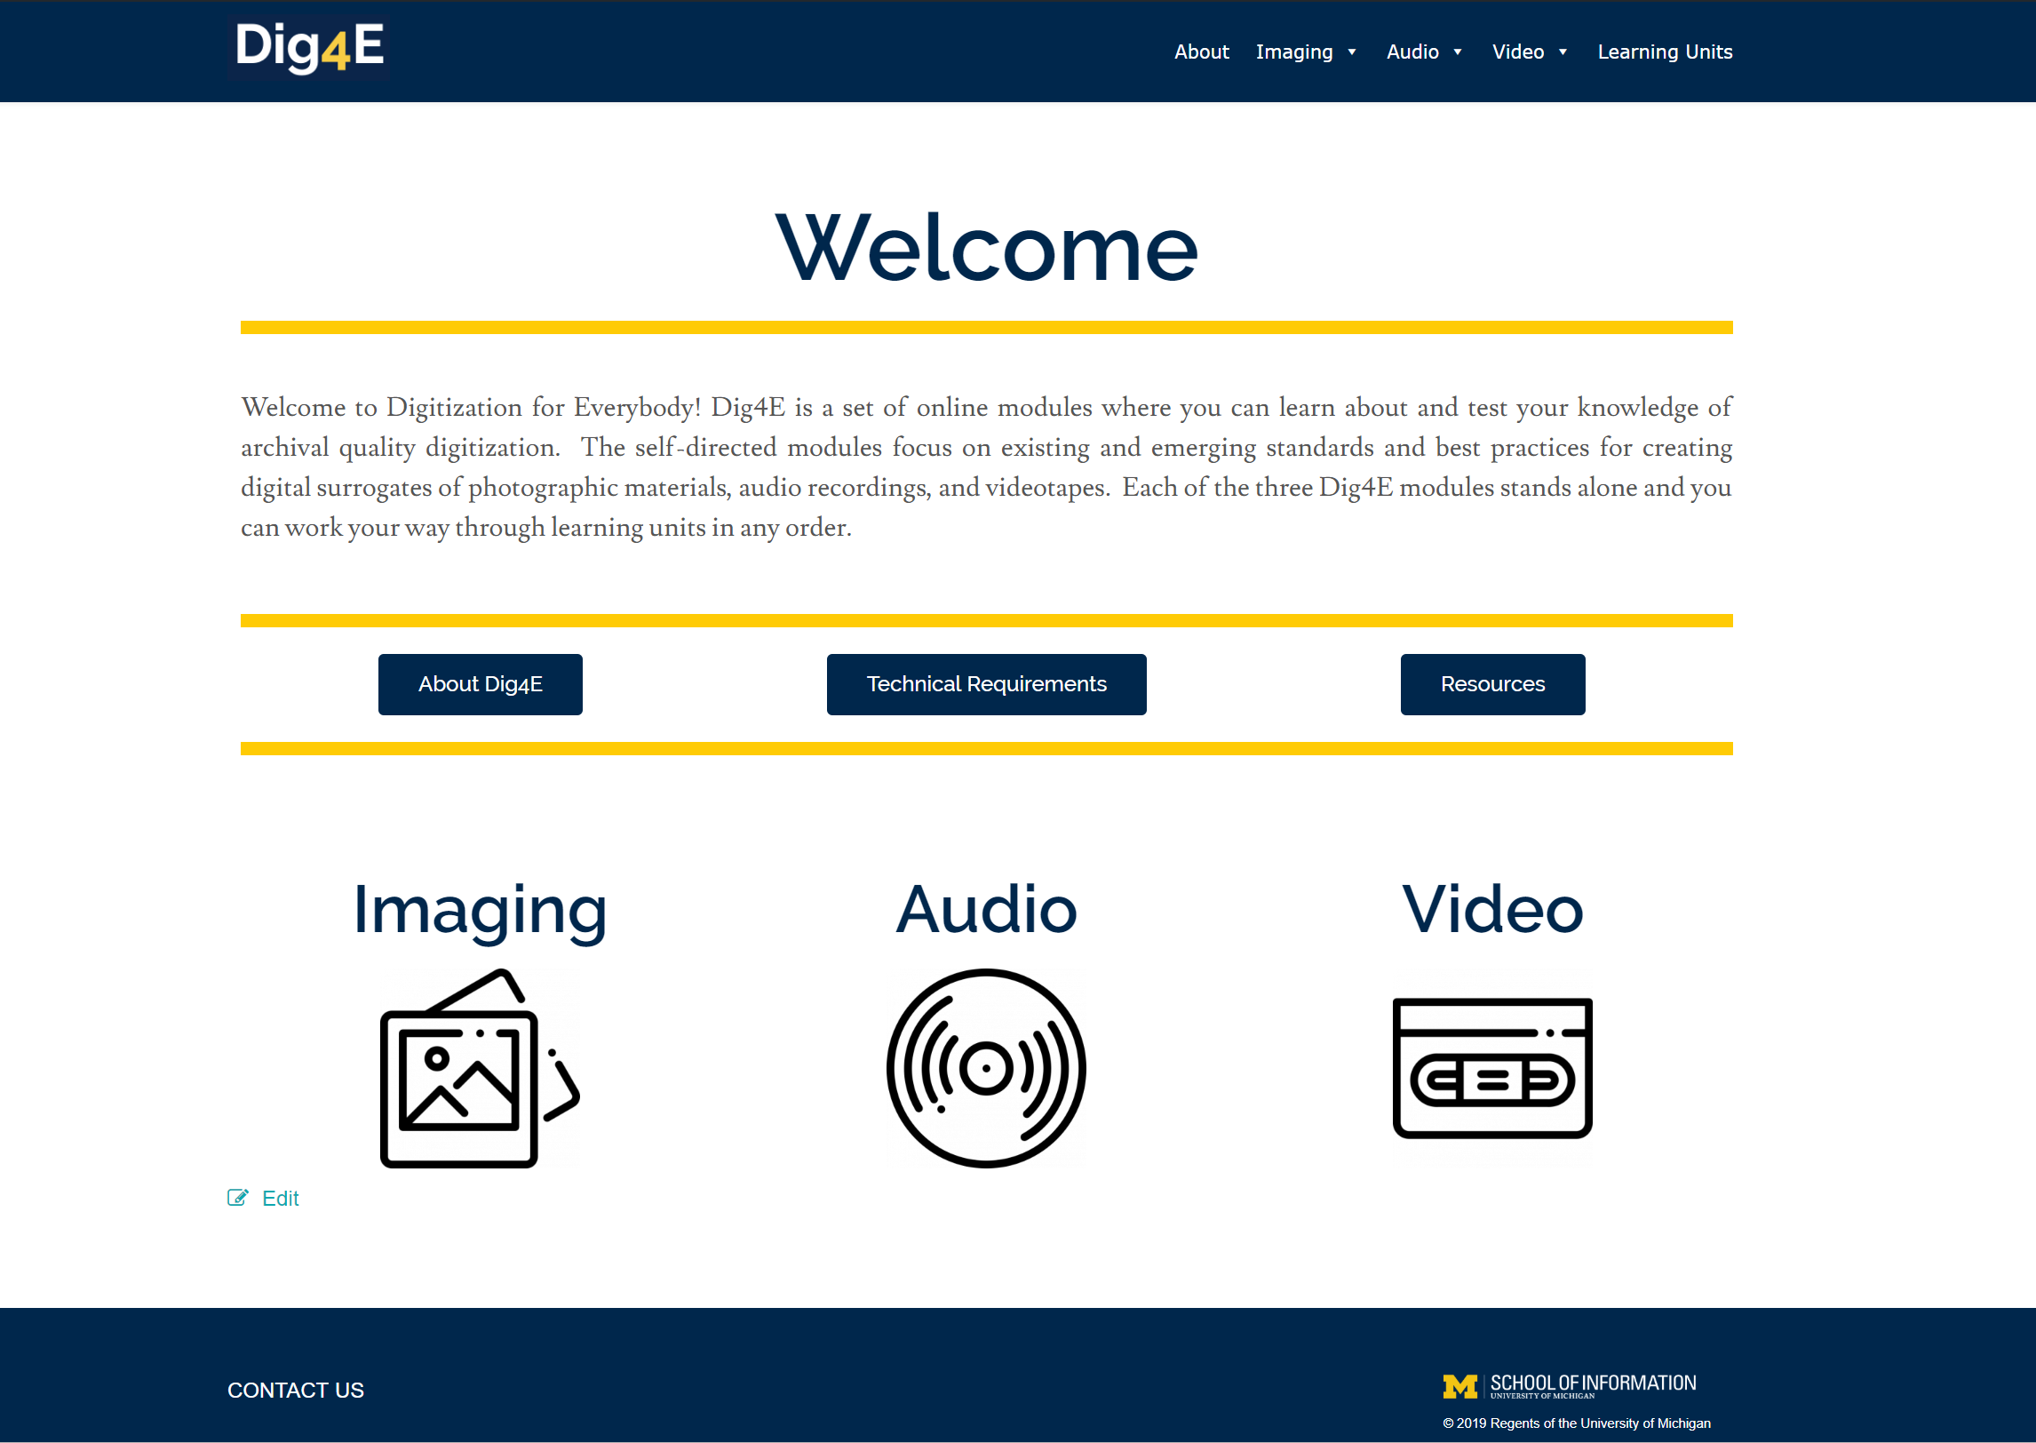

Slide 5
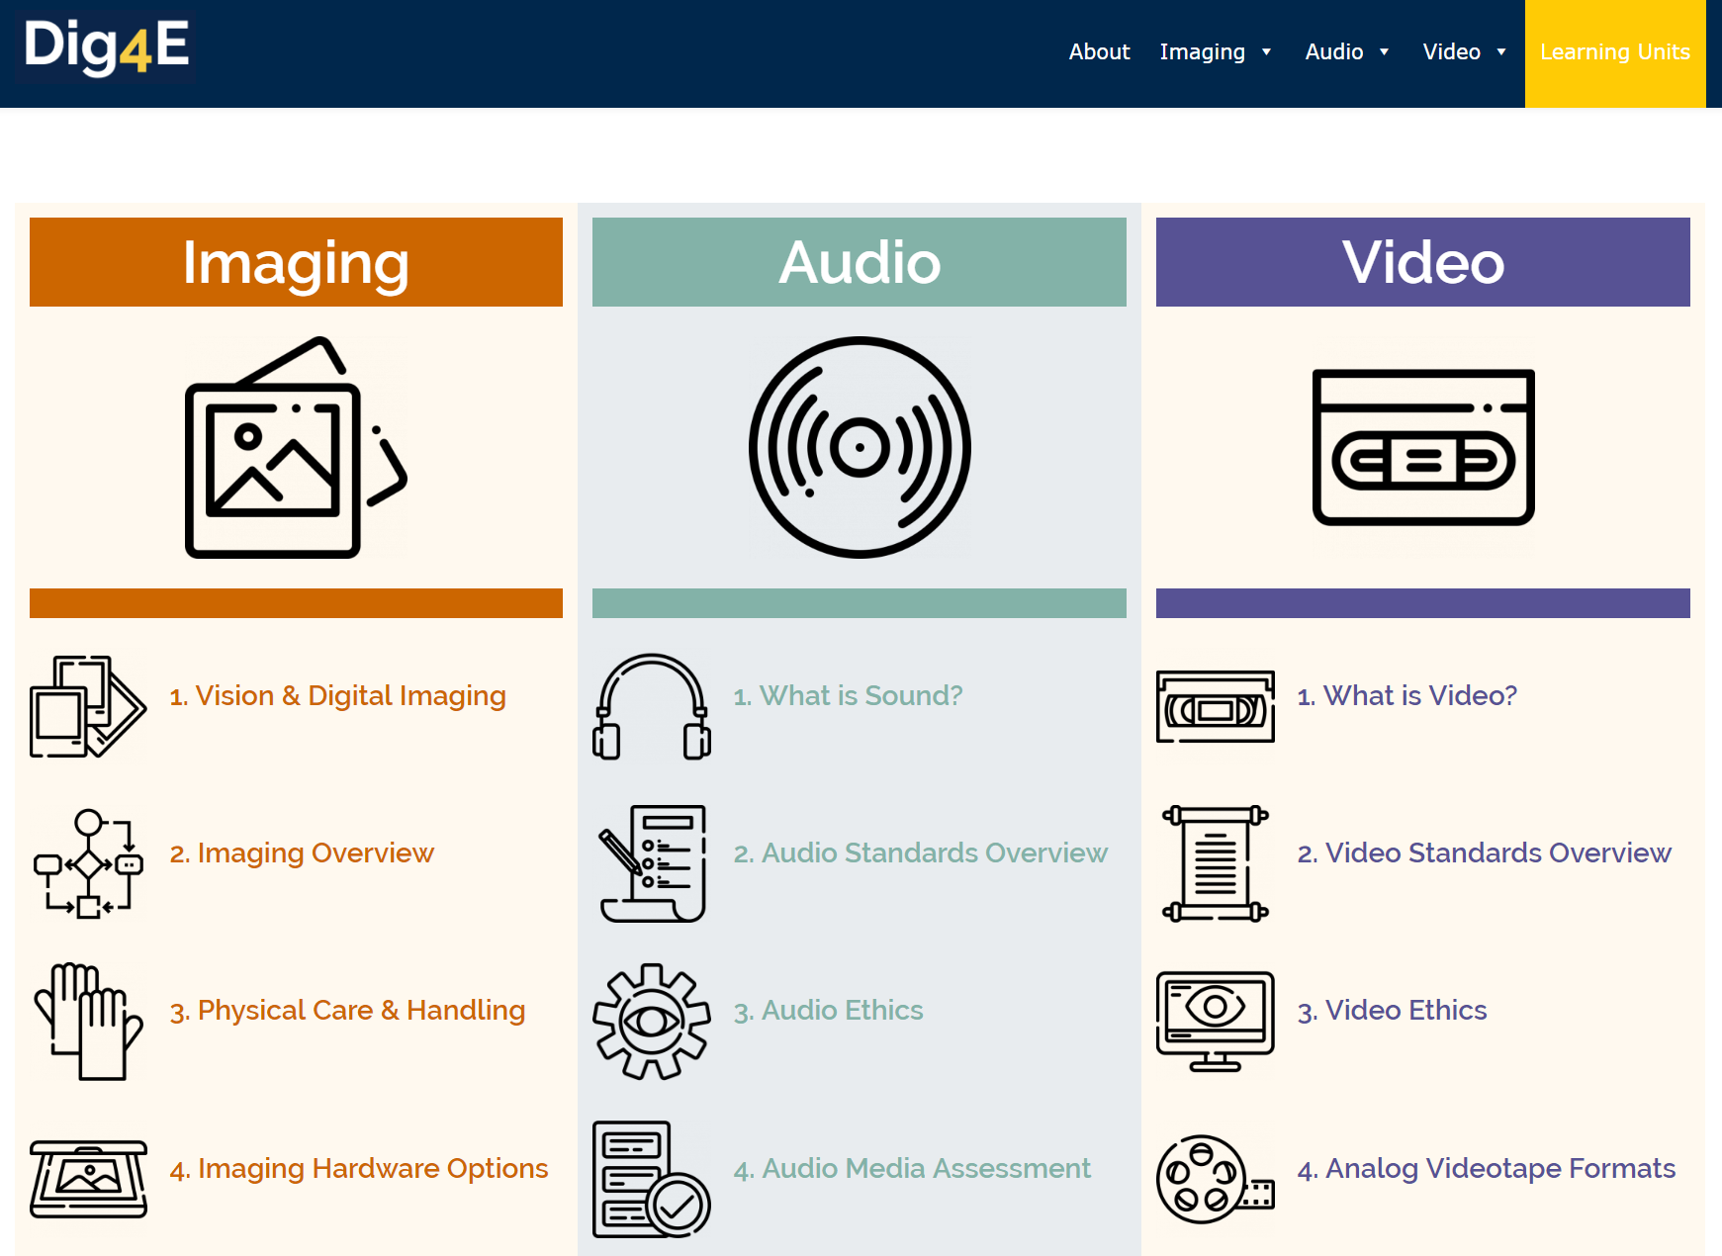

Slide 6
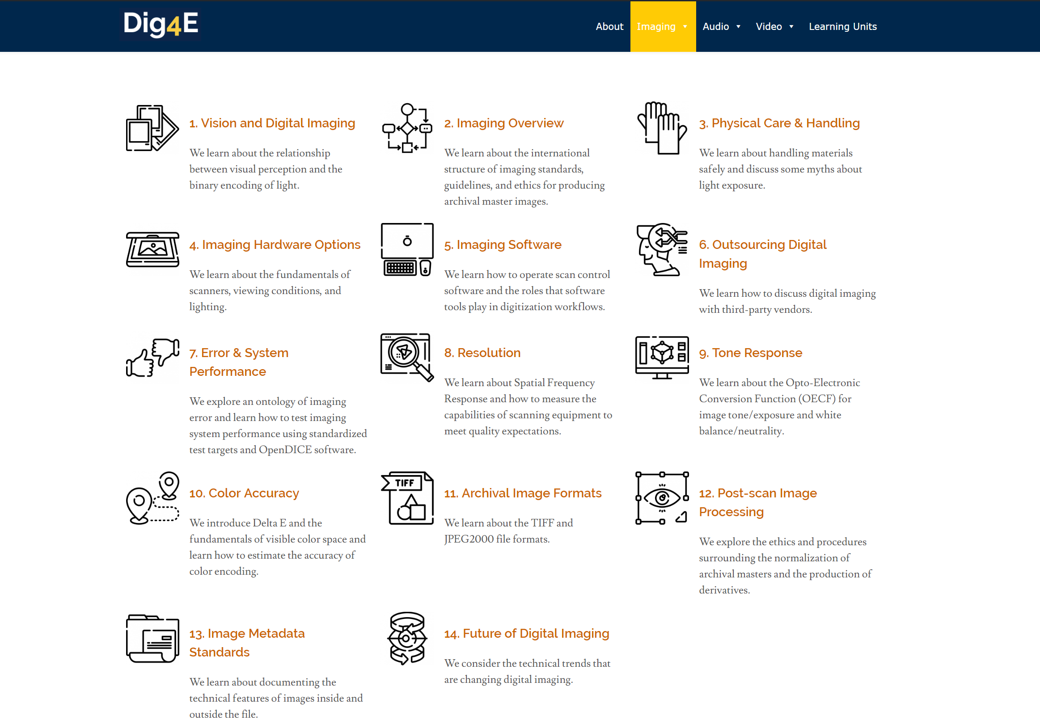

Slide 7
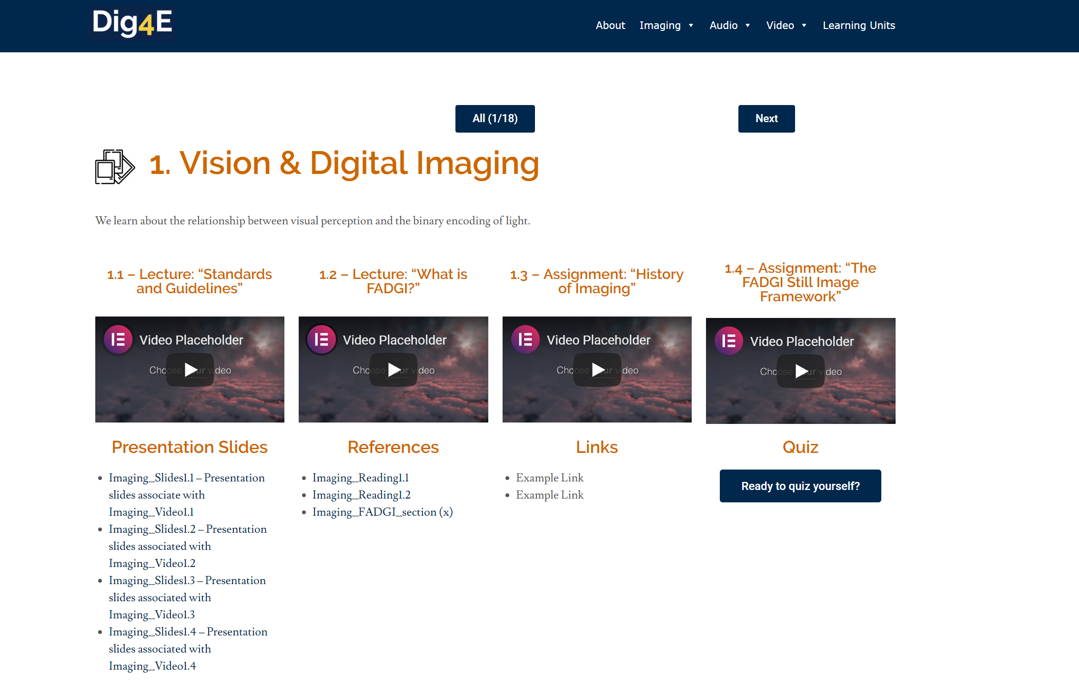

Slide 8
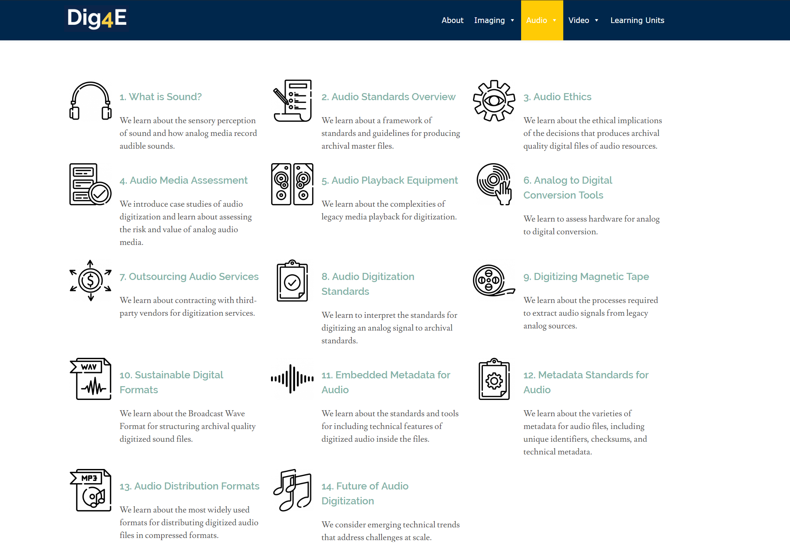

Slide 9
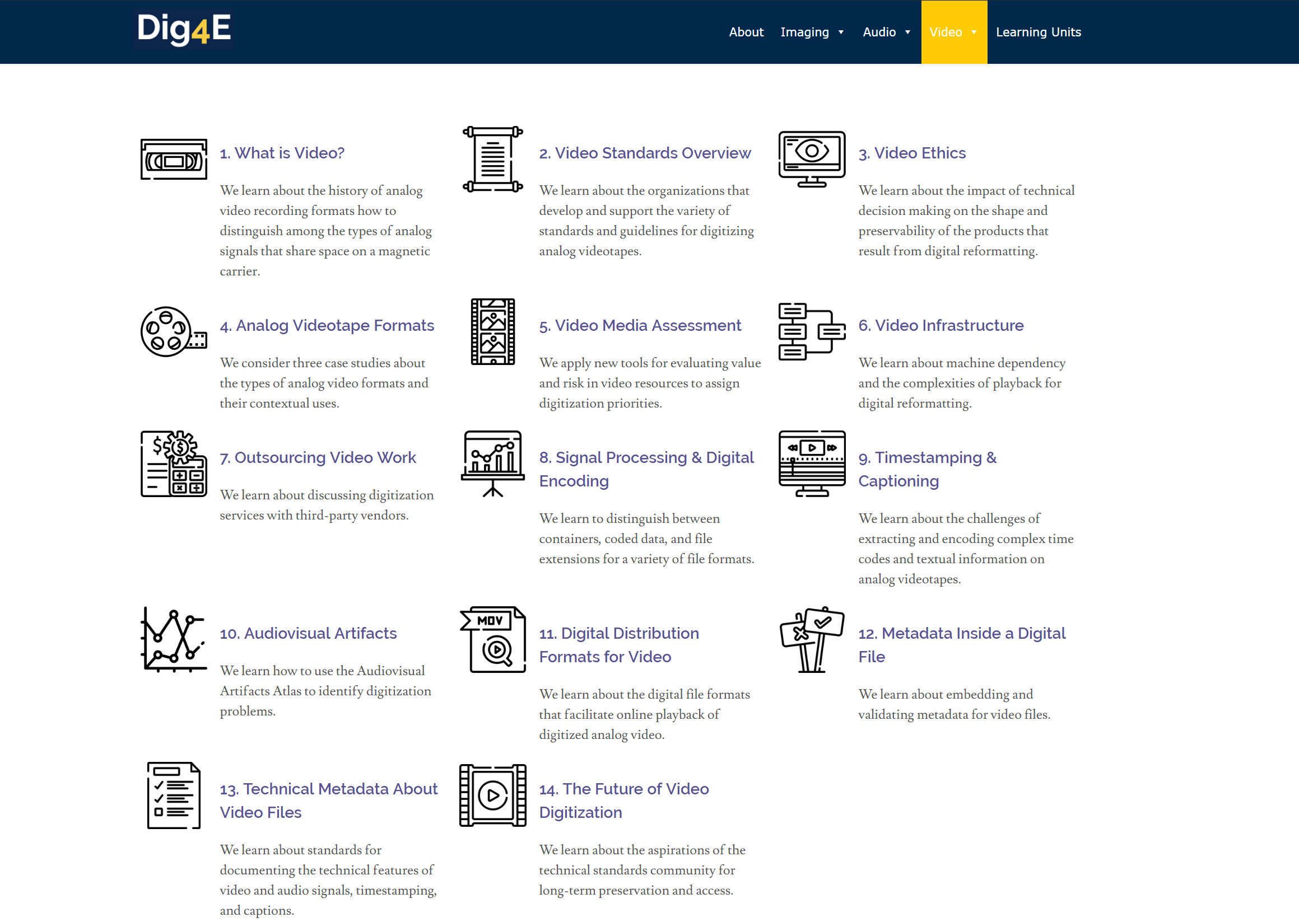

Slide 10
Dig4E Technical Architecture
Dig4E Home
User Interface
Imaging
Audio
Video
WordPress
LAMP Servers
Linux
Apache
MySQL
Php
Secure Code
Py4E
Imaging
Audio
Video
Open Content
GitHub (Dig4E)
Repositories
Preservation
UM Digital MiSpace

Slide 12
Thank you for your attention!

